Slide 1





Project: Home Irrigation Control System (HICS) Team: SmartGrass
Team Status Report
May 1st, 2015
Belachew
Haile-Mariam
Gautam
Adhikari
Jeremiah
O’Connor
Tung
Vo
Notes:
This presentation demonstrates the new capabilities of PowerPoint and it is best viewed in Slide Show. These slides are designed to give you great ideas for the presentations you’ll create in PowerPoint 2010!
For more sample templates, click the File tab, and then on the New tab, click Sample Templates.

Slide 2
PACKAGING PROGRESS
Power Housing and Cables
Made the wires shorter and organized the wires going in and out of the HICS.
Used Velcro to permanently fix the location of hardware.
Taped wires and labeled relay modules.
Glued , taped and soldered all connecting wires.
Gave HICS a unibody design.

Slide 3
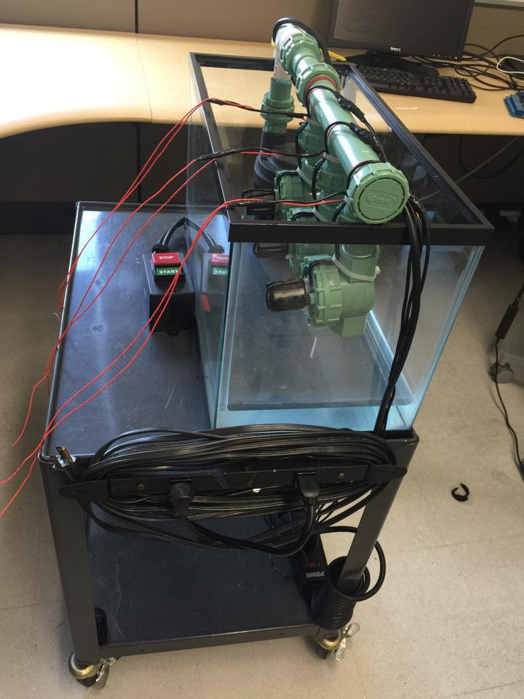
PACKAGING PROGRESS
Power Housing and Cables

Slide 4
PROTOTYPE DEVELOPEMENT
SENSORS
Tested sensors with different environments.
Calibrated the readings.

Slide 5
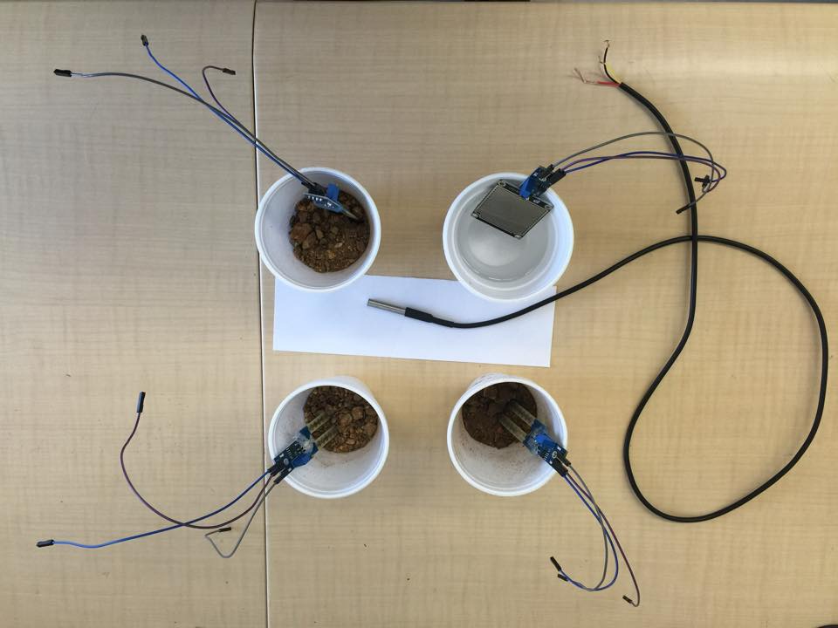
Prototype Development

Slide 6
PROTOTYPE DEVELOPEMENT
INTEGRATION PROCRESS
Hardware connected with each other.
Established good connection between hardware and software.
Hardware status and readings updated on the web page.

Slide 7
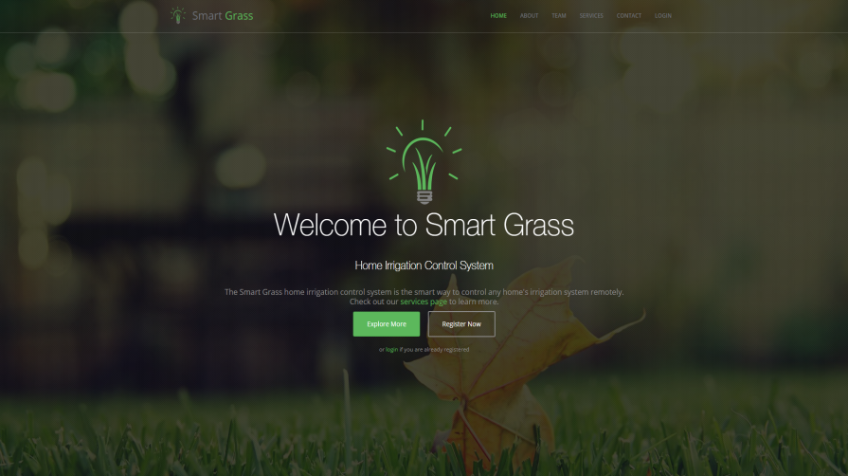
PROTOTYPE DEVELOPEMENT
Web Application UI

Slide 8
Prototype Development
Web Application UI
Added functions
Made user friendly interface

Slide 9
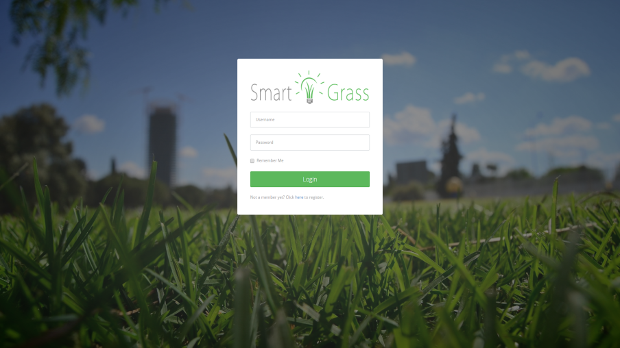
WEB APPLICATION PROGRESS
Web Application UI

Slide 10

Any Questions?
?

